Slide 1
Modeling damages, extremes and impacts:
Design your own climate adaptation strategy – a practical application of open-source probabilistic damage modeling 1 Sep 2016
David N. Bresch, ETH Zürich/MeteoSwiss
dbresch@ethz.ch , dbresch@meteoswiss.ch
Inspired by/based on (explains the slide layout, too ;-) “Climate Change Uncertainty and Risk: from Probabilistic Forecasts to Economics of Climate Adaptation”, spring term lecture at ETH,
by Reto Knutti, IAC ETH and David Bresch, Swiss Re.
All material available at https://github.com/davidnbresch/climada
Manual: https://github.com/davidnbresch/climada/blob/master/docs/climada_manual.pdf

Slide 2
About the workshop
Climate adaptation is an urgent priority for the custodians of national and local economies, such as finance ministers and mayors. Such decision makers ask: 1) What is the potential climate related damage to our economies and societies over the coming decades? 2) How much of that damage can we avert, with what measures? 3) What investment will be required to fund those measures - and will the benefits of that investment outweigh the costs?
Put yourself in the shoes of a local decision maker and gain hands-on experience with the economics of climate adaptation (ECA) methodology as implemented in the open-source climada tool (https://github.com/davidnbresch/climada). Working in small teams, this will enable you to understand the effect of weather and climate on an economy - and to identify actions to minimize that impact at lowest cost. It demonstrates how to integrate adaptation with economic development and sustainable growth.
Using state-of-the-art probabilistic modeling, we will estimate the expected economic damage as a measure of risk today, the incremental increase from economic growth and the further incremental increase due to climate change. We will then build a portfolio of adaptation measures, assessing the damage aversion potential and cost-benefit ratio for each measure. The resulting adaptation cost curve will help us compare results at the end of the workshop - which will conclude with a critique of the methodology.

Slide 3
Recommended reading
The climate resilience story: http://media.swissre.com/documents/sigma1_2014_en.pdf#page=17
Short introduction to the Economics of Climate Adaptation (ECA) methodology and global overview of case studies done so far: http://media.swissre.com/documents/Economics_of_Climate_Adaptation_focus_infrastructure.pdf
Reference: the climada manual (and access to the full tool, ready to use with MATLAB or Octave): https://github.com/davidnbresch/climada/blob/master/docs/climada_manual.pdf

Slide 4
What this workshop aims to provide
Climate adaptation: Different perspectives on the problem of understanding, quantifying and communicating probability, uncertainty and risk, and how to make decisions in their presence
Opportunities to think about a problem, rather than providing a recipe for a solution
Hands on experience with an operationally used open-source tool
Opportunities for discussion
No worries, hands-on is less than 30 slides away

Slide 5
Global reasons for concerns
(Figure: IPCC AR5 WG2, 2014, Assessment Box SPM.1 Figure 1)
Notes:
Cost of mitigation vs. Cost of adaptation

Slide 6
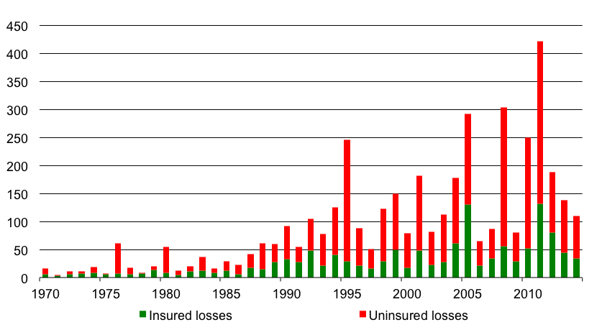
Natural catastrophe damages on the rise and: Massive gap between economic and insured damage
Natural catastrophe damages 1970-2014, in USD billion
Note: Amounts indexed to 2014. Source: Swiss Re sigma catastrophe database, http://www.swissre.com/sigma/
Note: Loss amounts indexed to 2009 Source: Swiss Re, sigma No 2/2010
Notes:
Question: What’s the key driver here?
Major disasters:
- 1994: Northridge earthquake (US)
- 1995: Hurricane Opal, floods (US, Mexico, Gulf of Mexico) ; Great Hanshin earthquake in Kobe (Japan)
- 1999: Winter storm Lothar (Switzerland, UK, France et al) ; Typhoon Bart/No 18 (Japan) ; Winter storm Martin (Spain, France, Switzerland)
- 2001: Terror attack on WTC, Pentagon and other buildings (US) ; Tropical storm Allison, floods (US)
- 2004: Hurricane Ivan, damage to oil rigs (US, Caribbean, Barbados et al) ; Hurricane Charley, floods (US, Cuba, Jamaica et al)
- 2005: Hurricane Katrina, floods, damn burst, damage to oil rigs (US, Gulf of Mexico, Bahamas, North Atlantic) ; Hurricane Wilma, floods (US, Mexico, Jamaica, Haiti et al) ; Hurricane Rita, floods, damage to oil rigs (US, Gulf of Mexico, Cuba)
- 2008: Hurricane Ike, floods, offshore damage (US, Caribbean, Gulf of Mexico et al)
- 2010: Earthquake triggers tsunami (Chile) ; Earthquake (New Zealand) ; Winter storm Xynthia (France, Germany, Belgium et al)
- 2011: Floods (Australia) ; Earthquake (New Zealand) ; Earthquake, tsunami (Japan) ; Floods (Thailand) ; Earthquake (Turkey)

Slide 7
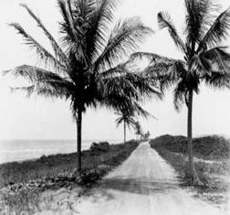
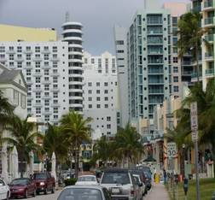
Note on drivers
Ocean Drive, FL, 1926
The upward trend in natural catastrophe damage is driven by:
Higher insurance penetration
Growing property values
Coastal value concentration
Higher vulnerabilities
Climate change
Trend decomposition going forward ?
→ Need for climate resilient development
Ocean Drive, FL, 2000
Notes:
7

Slide 8
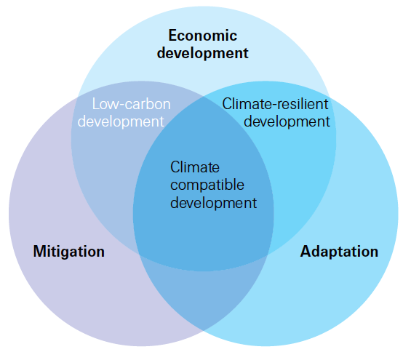
The need for climate-resilient development
→ How would you tackle this? Adaptation first, development second? Or vice versa?
Notes:
8
Question: how to go about? How would you tackle this? Adaptation first, development second? Or vice versa?
Remember what we discussed in natural catastrophe modelling and scenarios…

Slide 9
Climate-resilient development or: Economics of climate adaptation (ECA)
Objectives
Provide decision makers with the facts and methods necessary to design and execute a climate adaptation strategy
Supply financial institutions, potential funders and insurers with the information required to unlock and deepen global adaptation finance and risk transfer markets
Key features of the methodology:
Follow a rigorous risk management approach to assess local total climate risk, the sum of
today’s climate risk,
the economic development paths that might put greater population and value at risk (→ projection)
the additional risks presented by climate change (→ scenarios)
Propose and prioritize a basket of adaptation measures to address total climate risk on an economic basis
Notes:
9

Slide 10
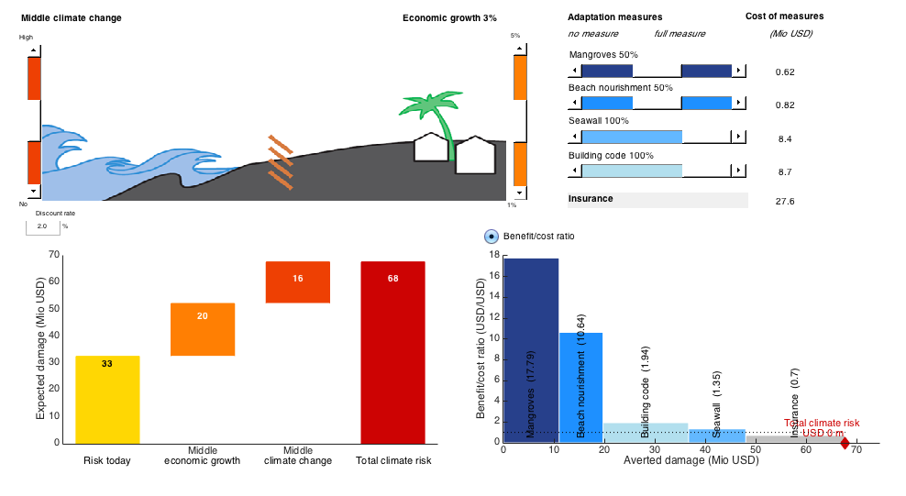
Economics of climate adaptation (ECA)
Key outputs of the methodology (1/2)
Risk today+economic growth+climate change: the ‘waterfall chart’
Notes:
10

Slide 11
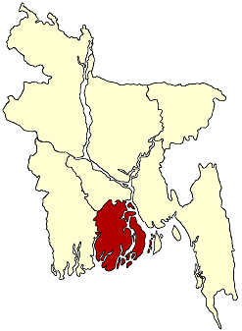
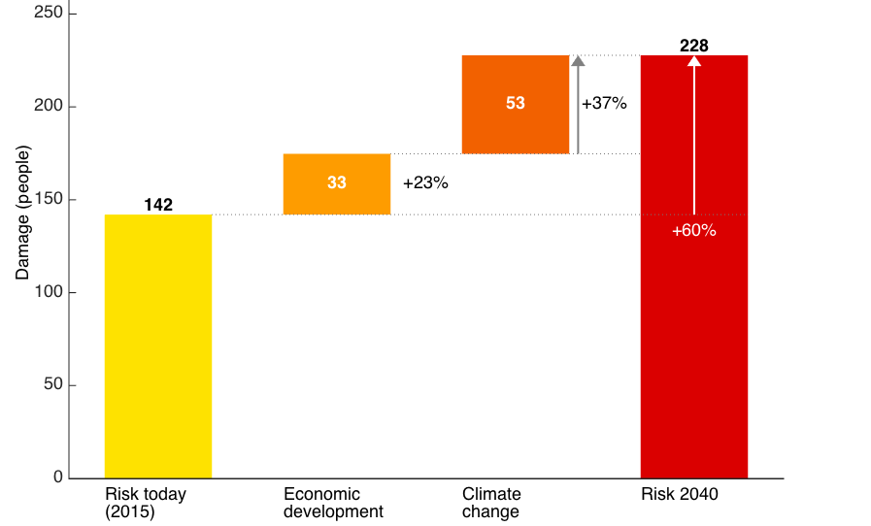
Economics of climate adaptation (ECA)
Key outputs of the methodology (1/2)
Risk today+development+climate change: the ‘waterfall chart’
Annual average expected flood victims in the city of Barisal, Bangladesh
Barisal
?
Notes:
11

Slide 12
Economics of climate adaptation (ECA)
Key outputs of the methodology (2/2)
The adaptation cost curve: adaptation measures sorted by cost and benefit
USD 68 m
Notes:
12

Slide 13
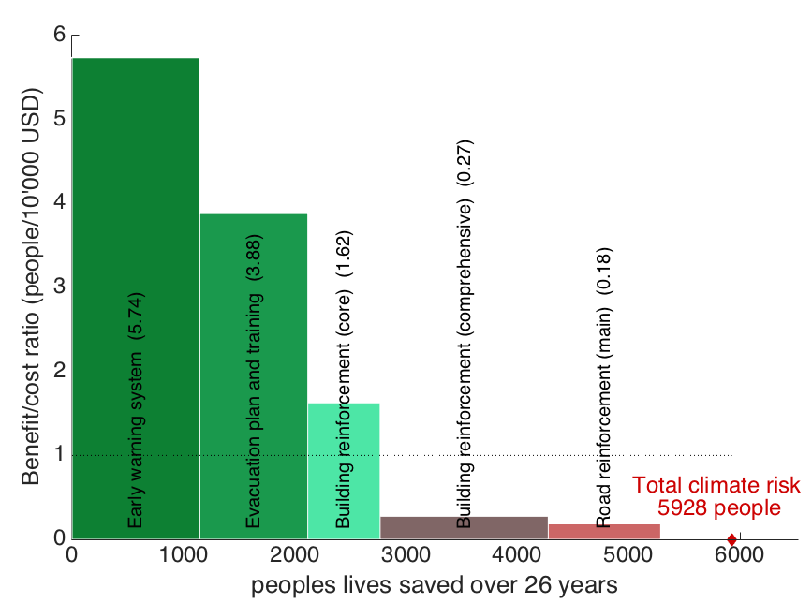
Economics of climate adaptation (ECA)
Key outputs of the methodology (2/2)
The adaptation cost curve: adaptation measures sorted by cost and benefit
→ Powerful measures exist to save people’s lives
USD 68 m
Notes:
13

Slide 14
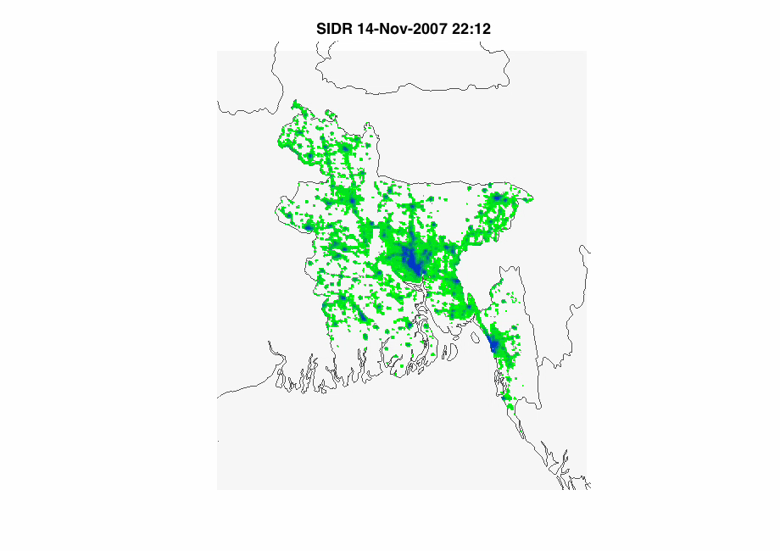

climada: High-resolution (1x1km) damage model
Bangladesh
green to blue: assets | yellow to red: damage
climada
Notes:
Movie (if it works) or stills (next two slides)
Stress high-resolution and end-user impact (damage to their assets, livelihoods)

Slide 15
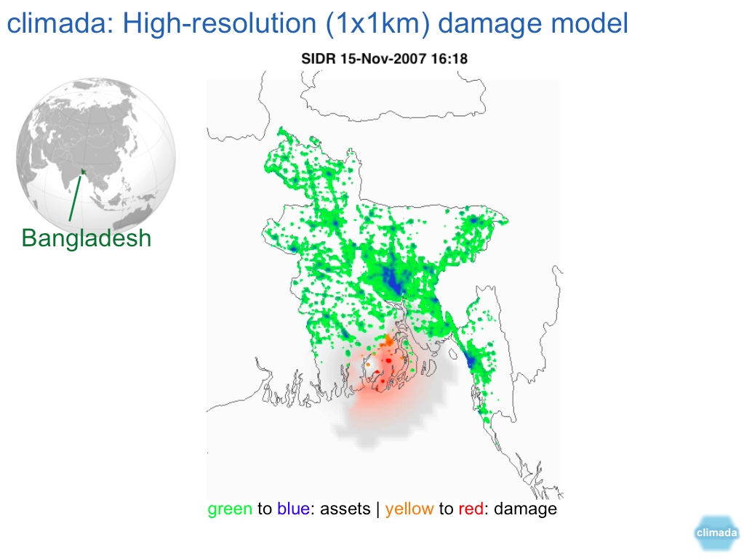
climada: High-resolution (1x1km) damage model
Notes:
Movie (if it works) or stills (next two slides)
Stress high-resolution and end-user impact (damage to their assets, livelihoods)

Slide 16
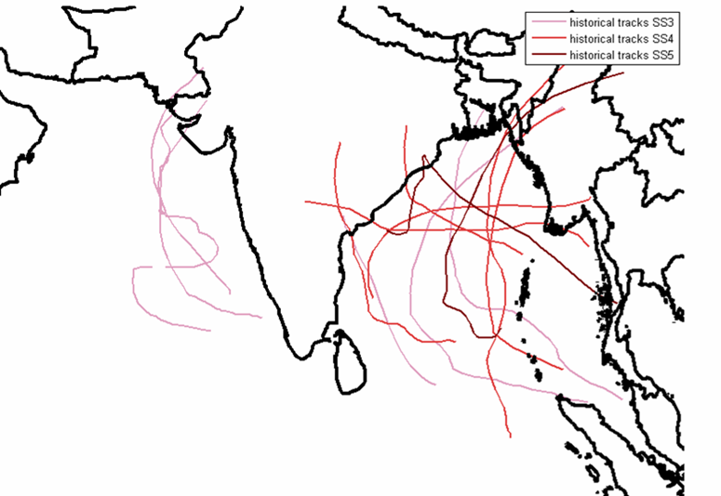
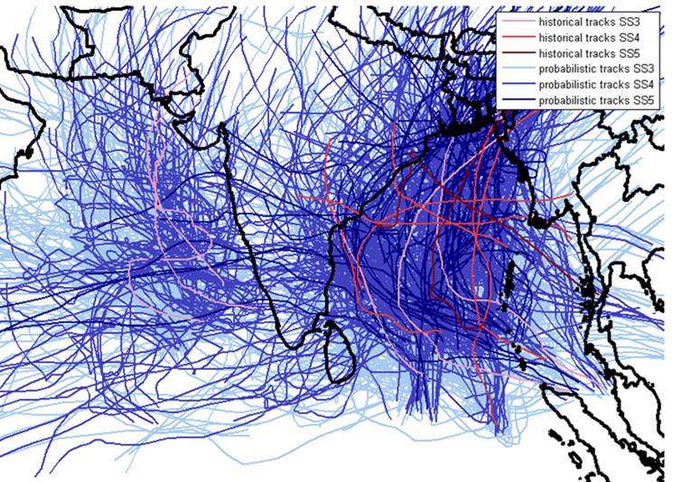
Tropical cyclones in the Indian Ocean
historic ~ 25 years
probabilistic ~ 5‘000 years
climada
Notes:
How to deal with sparse (historic) data, to deal with aleatory uncertainty…
Idea of a time-lapse camera, playing through thousands of possible outcomes. Use physically consistent, plausible events (→ requires process understanding MORE THAN big data)

Slide 17
Risk
Risk concerns the expected value of one or more outcomes of one or more future events.
Risk = Probability Severity
Risk is defined (e.g. ISO 31000) as the effect of uncertainty on objectives (whether positive or negative).
expected value
Notes:
17

Slide 18
Risk¹ Management
Risk identification: Shared mental model, the prerequisite for awareness
perception is based on a shared mental model → wider sharing builds awareness
Risk analysis: Quantification, the basis for decision-making
Risk model: the quantitative expression of a shared mental model → allows to assess risk mitigation options
Risk mitigation: Prioritization based on metrics, options are to
avoid
reduce
prevent
transfer : Insurance puts a rice tag on risks → incentive for prevention
or retain the risk ¹ Risk = Probability Severity
Notes:
18

Slide 19
Risk Management Cycle
Identify
Review
Analyze
Options:
Avoid
Reduce
Prevent
Transfer
Retain
Implement
Plan measures

Slide 20
ECA¹ – the methodology
Identify → Analyze → Plan measures → Implement
What
Where and
What is the
What
How can
What is the
Input into
measures
Input into
from what is
magnitude of
measures
measures be
magnitude of
adaptation
should be
adaptation
the region
the expected
should be
implemented?
the expected
strategy
considered?
strategy
most at
loss?
considered?
loss?
risk?
Map of areas at risk
Identify most relevant hazard(s) in case location
Identify areas that are most at-risk, by overlaying hazard(s) on:
Population
Economic value (GDP)
Estimate of potential loss
Hazard: Develop frequency and severity scenarios
Assets: Quantify assets and income value in area at risk
Vulnerability: Determine vulnerability of assets and incomes to the hazard
Set of adaptation measures
Identify potential adaptation measures
Determine societal costs and benefits and basic feasibility
Interviews with experts
Economic analysis
Implementation assessment
Assess current progress against the measures
Understand requirements to implementation
Determine actions required to implement measures
¹Economics of Climate Adaptation
Notes:
20

Slide 21
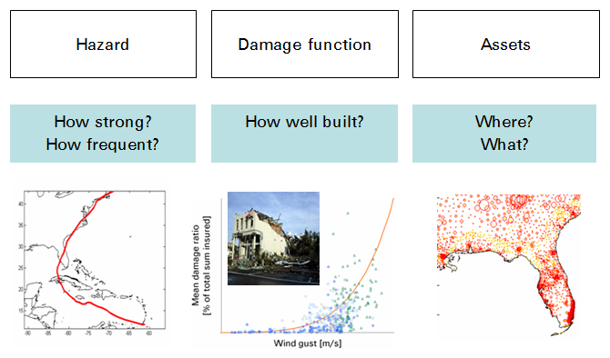
Natural catastrophe modelling
What is the
What is the
magnitude of
magnitude of
the expected
the expected
loss?
loss?
Notes:
21

Slide 22
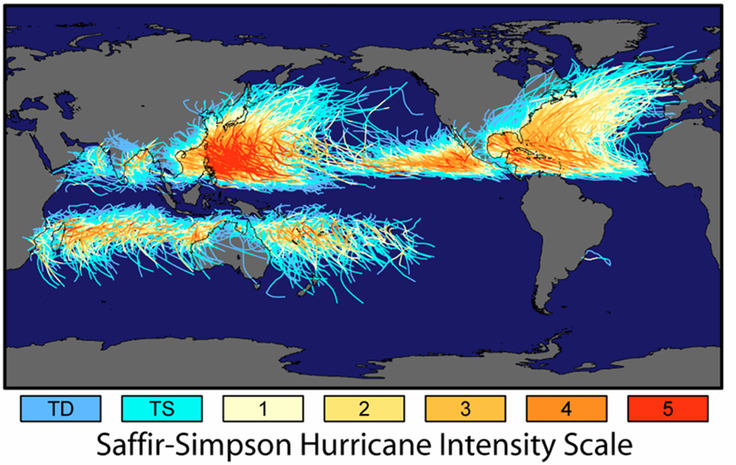
Tropical cyclones
Notes:
22

Slide 23
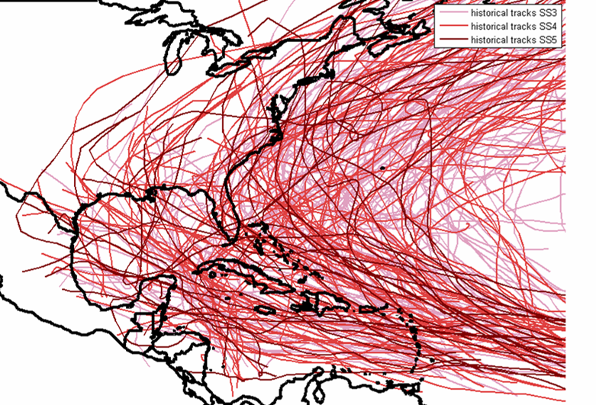
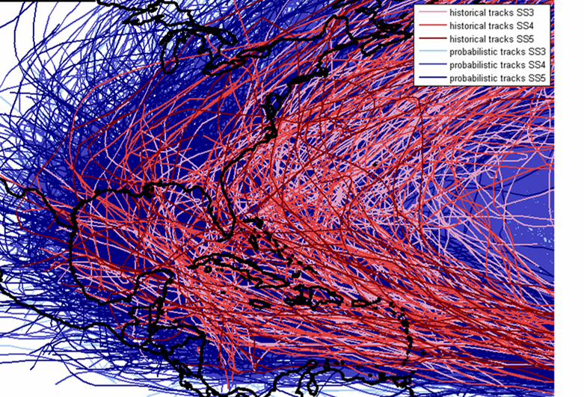
Tropical cyclones in the North Atlantic
historic ~100 years
probabilistic ~10‘000 years
Notes:
23

Slide 24
Tropical cyclones in the Indian ocean
historic ~ 25 years
probabilistic ~ 5‘000 years
Notes:
24

Slide 25
Tropical cyclone intensity – the wind field
We use the Holland wind field model
The 1-min sustained wind at gradient wind level (boundary layer height & no surface effects) is modelled using the Holland 2008 approach. It models the first-order vortex of a tropical cyclone.
The translational speed (also called celerity) is added geometrically.
Holland, G. J., 1980: An analytic model of the wind and pressure profiles in hurricanes. Monthly Weather Review, 108, 1212-1218.
Vickery, P.J. and D. Wadhera, 2008: Statistical models of Holland pressure profile parameter and radius to maximum winds of hurricanes from flight-level pressure and H*wind data. J. Appl. Meteor. Clim.
Notes:
25
Holland, G. J., 1980: An analytic model of the wind and pressure profiles in hurricanes. Monthly Weather Review, 108, 1212-1218.
Vickery, P.J. and D. Wadhera, 2008: Statistical models of Holland pressure profile parameter and radius to maximum winds of hurricanes from flight-level pressure and H*wind data. J. Appl. Meteor. Clim.
Holland, G. J., 2008: A Revised Hurricane Pressure–Wind Model, Monthly Weather Review, 136, 3432-3445.

Slide 26
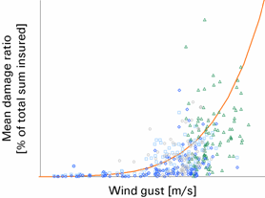
Notes on damage function
Mean Damage Ratio
Hazard Intensity
Uncertainty of the hazard intensity + Uncertainty of the damage results in Convoluted Distribution
Notes:
26

Slide 27
Basket of adaptation measures
What
What
measures
measures
should be
should be
considered?
considered?
Hazards
Vulnerabilities
Assets
→ adaptation measures for Miami, Florida, any ideas?
Notes:
27
Question: Brainstorm ten adaptation measures for Florida, please…

Slide 28
Excursion: Discounting – Present value calculation
All consideration are net of inflation, means all future costs and benefits expressed in terms of the amount they could purchase at today’s prices. If we expect 3% inflation next year, then $103 at next year’s prices has the same purchasing power as $100 at today’s prices. So we can refer to it as $100 in ‘real’ or inflation-adjusted dollars (or any other currency).
Is it better to receive $100 today or to receive $100 in the future? → clearly better to receive $100 today and to put it into a bank account. At say 2% interest, you will possess $122 [=100*(1+0.02)¹⁰] in ten years from now. Or you only need to put $82 into the bank today to receive $100 in ten years [=100/(1+0.02)¹⁰]. In the jargon of economics, $82 today is the present value of 100$ to be received ten years from now, at a discount rate of 2%.
The present value (PV) is the amount you would have to put in a bank account today, earning interest at discount rate, to end up with the target amount at the specified time in the future.
Notes:
28
There are four primary reasons for applying a positive discount rate:
First, positive rates of inflation diminish the purchasing power of dollars over time.
Second, dollars can be invested today, earning a positive rate of return.
Third, there is uncertainty surrounding the ability to obtain promised future income. That is, there is the risk that a future benefit (e.g., enhanced fish catches) will never be realized.
Finally, humans are generally impatient and prefer instant gratification to waiting for long-term benefits.

Slide 29
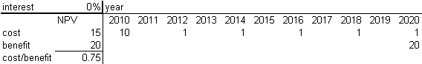
Costs and benefits – example (1/2)
In most cases, one deals with cost and benefit streams or patterns over years. Hence one needs to discount (complex) payment patterns – and often with a time-dependent yield curve. A simple example shall illustrate this:
Let’s assume we expect a climate-related loss of 20 mio CHF by 2026 and hence evaluate the option to invest in prevention (the cost) starting 2016 in order to avert the loss (the benefit).
Let’s further assume the preventive measure be a dam to be built in 2016 (at a cost of 10 mio CHF) and recurring maintenance costs of 1 mio CHF every second year.
Is it worth building the dam?
No discounting, cost: dam, benefit: averted loss, in mio CHF:
2016 2017 2018 2019 2020 2021 2022 2023 2024 2025 2026
Notes:
29

Slide 30
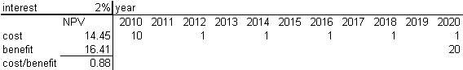
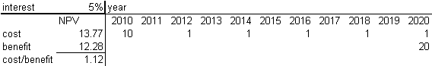
Costs and benefits – example (2/2)
at 2% discount rate:
cost=10+0/(1+2%)+1/(1+2%)²+0/(1+2%)³+1/(1+2%)⁴…
2016 2017 2018 2019 2020 2021 2022 2023 2024 2025 2026
2017 2018 2019 2020
at 5% discount rate:
2016 2017 2018 2019 2020 2021 2022 2023 2024 2025 2026
Notes:
30

Slide 31
The adaptation cost curve
What
What
measures
measures
should be
should be
considered?
considered?
How can
measures be
implemented¹ ?
¹The ‘how’ refers primarily to the sequence or priority and the financials, not the physical implementation
Notes:
31

Slide 32
What
What
measures
measures
Adaptation cost curve – the recipe (one measure)
should be
should be
considered?
considered?
Calculate present value (PV) of costs of measure
Today (year 2016): assets, hazard as per today (probabilistic model)
calculate annual expected loss with no measures
calculate annual expected loss with measure applied
→ difference 2.1) minus 2.2) gives you benefit of measure today
Future (year 2030): assets, hazard as in the future (prob+scenario)
calculate future annual expected loss with no measures
calculate future annual expected loss with measure applied
→ difference 3.1) minus 3.2) gives you future benefit of measure
Discount benefits → horizontal axis of adaptation cost curve compare with PV of costs → vertical axis of adaptation cost curve
→ no worries, all implemented in climada, the open-source tool ;-)
How can
measures be
implemented¹ ?
Notes:
32

Slide 33
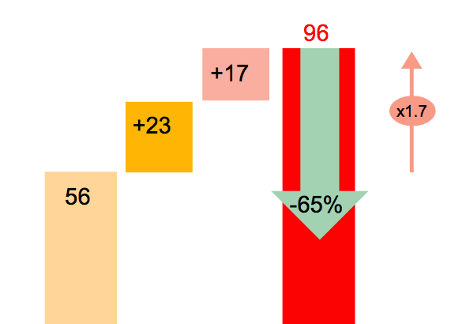
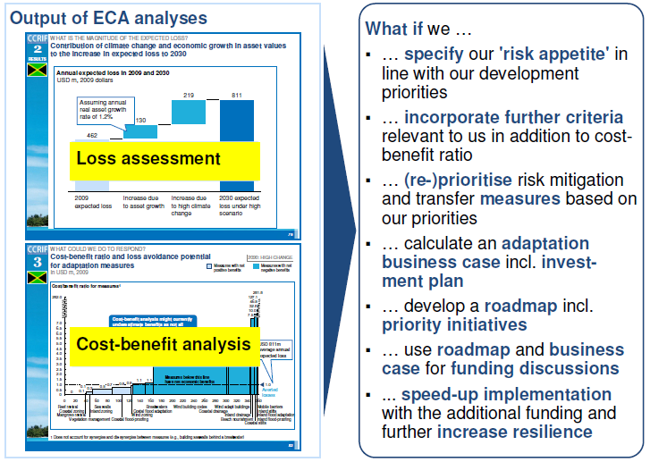
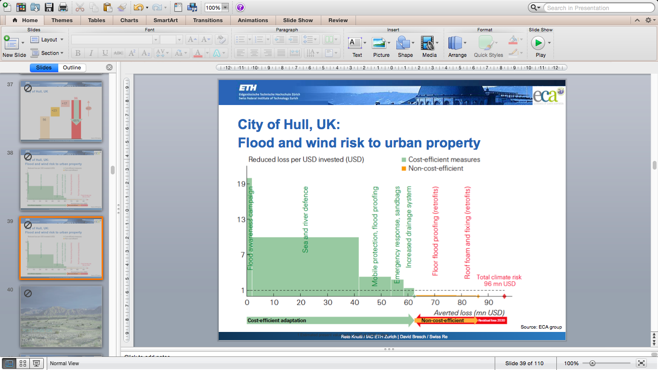
Roadmap and business case for adaptation funding
Loss assessment
Cost/benefit analysis

Slide 34
Workshop step-by-step
see the file climada_workshop_step_by_step.pdf for further instructions. Located in Desktop → climada → docs → exercises

Slide 35
A visual primer in MATLAB: climada_demo

Slide 36
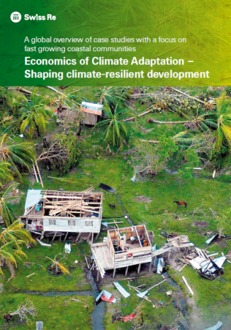
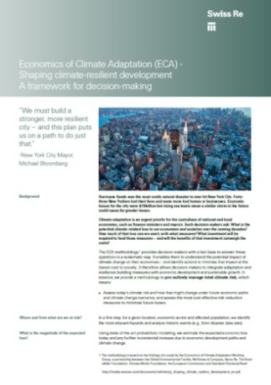
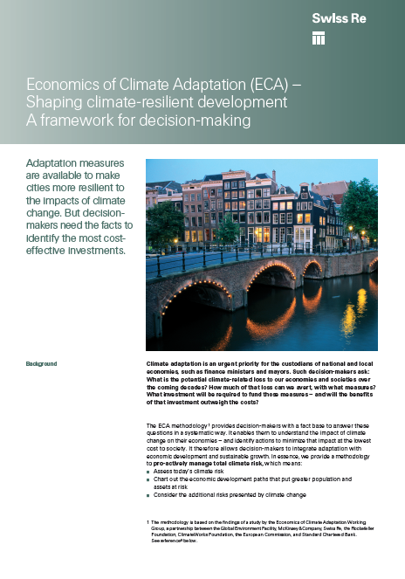

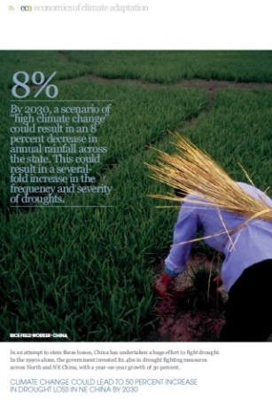
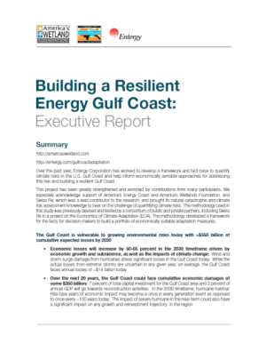
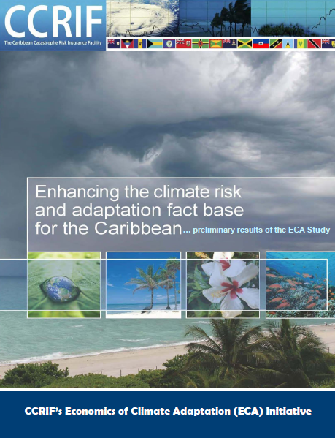
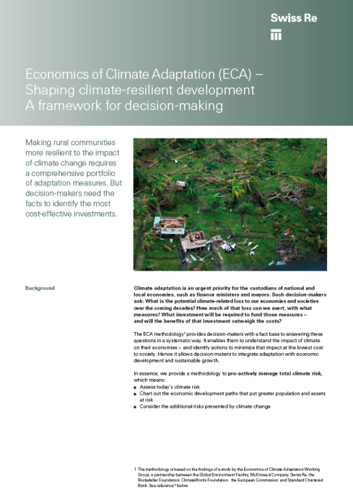
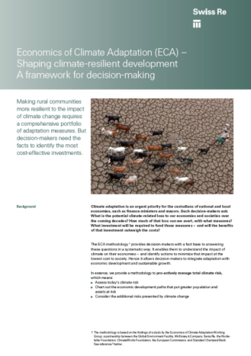
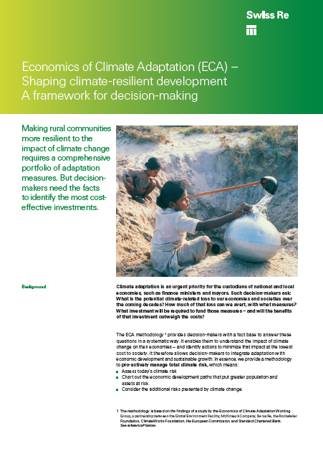
A global overview of ECA studies with a focus coastal communities
New York: Tropical cyclones and storm surge risk to a metropolis
Hull, UK: Flood and storm risk to urban property
ECA full report featuring the first 8 case studies,
164 pages
http://media.swissre.com/documents/Economics_of_Climate_Adaptation_focus_coastal_communities.pdf
http://media.swissre.com/documents/ECA_New_York_Gov_Factsheet.pdf
http://media.swissre.com/documents/Economics_of_Climate_Adaption_UK_Factsheet.pdf
China: Drought risk to agriculture
http://media.swissre.com/documents/ECA+Brochure-Final.pdf
http://media.swissre.com/documents/rethinking_shaping_climate_resilent_development_en.pdf#page=74
US Gulf Coast: Hurricane risk to the energy system
Caribbean: Hurricane risk to small islands
Guayana: Flash flood risk to a developing urban area
Mali: Risk of climate zone shift to agriculture
India: Drought risk to agriculture
http://media.swissre.com/documents/ECA+Brochure-Final.pdf
http://media.swissre.com/documents/Economics_of_Climate_Adaption_Guyana_Factsheet_en.pdf
http://media.swissre.com/documents/Economics_of_Climate_Adaptation_Factsheet_Mali.pdf
http://media.swissre.com/documents/Economics_of_Climate_Adaptation_India_Factsheet.pdf
http://media.swissre.com/documents/Entergy_study_exec_report_20101014.pdf

